Slide 1
Web Development 3
PHP & MySQL
Part 1(a)
Ashley Cahill
ashley.cahill@tus.ie

Slide 2
Recap
Exercise 1
Discount Calculator
Exercise 2
Discount Calculator with Validation

Slide 3
Learning Outcomes
History of MySQL.
MySQL Installations

Slide 4

Installation
XAMPP
NetBeans
MySQL Community Edition
MySQL Workbench

Slide 5
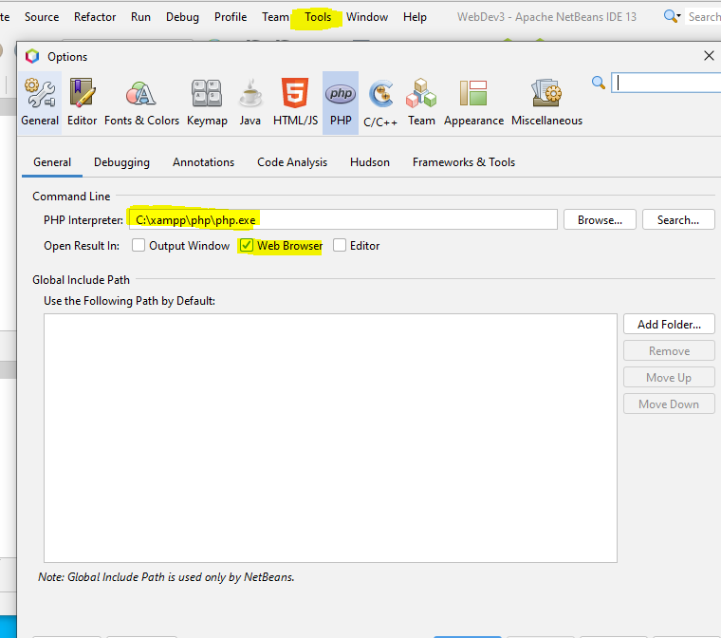
NetBeans Configuration Reminder…
NetBeans needs to know where the PHP Interpreter is before executing code
Also specify you want the output to be sent to the browser
On your computer, when XAMPP is running
The folder “C:\xampp\httdocs” is your local host root folder
Save/copy your files to this folder to test

Slide 6
History of MySQL
MySQL is one of the most widely used open source relational database management systems in the world.
Developed in 1994 by a Swedish company, MySQL AB.
Founded by David Axmark, Allan Larsson & Michael "Monty" Widenius.
Named after co-founder Monty Widenius's daughter, My.
First version internally released in 1995.

Slide 7
History of MySQL
1996, version 3.18 released.
1998, version 3.20 released for Windows.
2000, changed to Open Source.
2003 version 4.0 released.

Slide 8
History of MySQL
2005, Oracle purchased Innobase, the company which managed MySQL’s Innobase storage backend.
2005, version 5.0 released.
2006, Oracle purchased Sleepycat, the company that manages the Berkeley DB transactional storage engine of MySQL.

Slide 9
History of MySQL
2008, MySQL was acquired by Sun Microsystems.
2009, Oracle purchased Sun Microsystems along with MySQL copyrights and trademarks.
2010, version 5.5 released.
2018, version 8.0 released.

Slide 10
Database Installations
Software available on the Software Centre
MySQL Community Edition (sometimes called Community Server)
MySQL Workbench
Also available at
https://dev.mysql.com/downloads/mysql/
https://www.mysql.com/products/workbench/

Slide 11
Database Setup
Run XAMPP
Start the Apache Service
Start the MySQL Service
MySQL defaults to Port 3306
If the service fails to start (red text error message in XAMPP, update the my.ini config file to Port 3307
Must be updated in 2 places in the config file
See next slide!
If 3306 works … Hurray, we can run it from there.

Slide 12
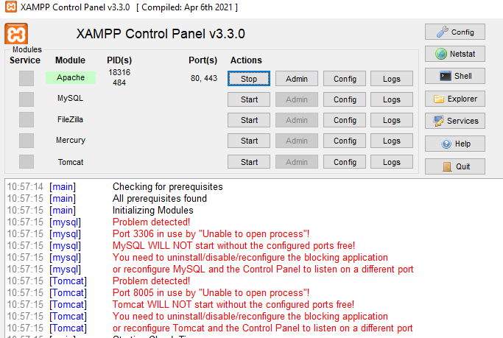
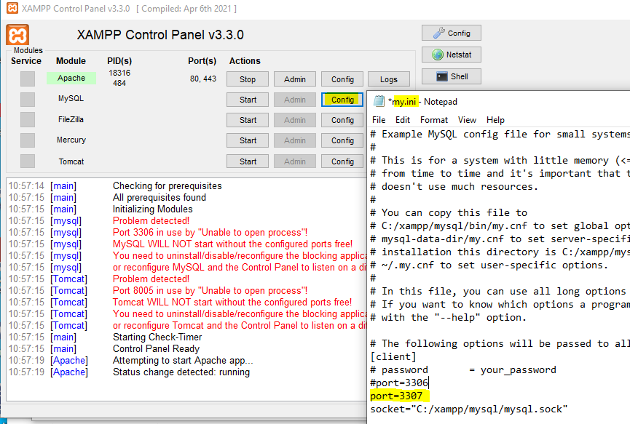
Database Setup
* Must be updated in 2 places in my.ini so do a Find/Search for port=3306 and update if needed

Slide 13
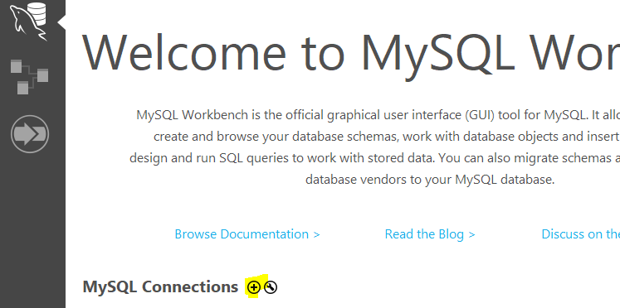
Creating Database Connection
Run XAMPP
Start the Apache Service
Start the MySQL Service
Open MySQL Workbench
Create New Connection
See next slide….

Slide 14
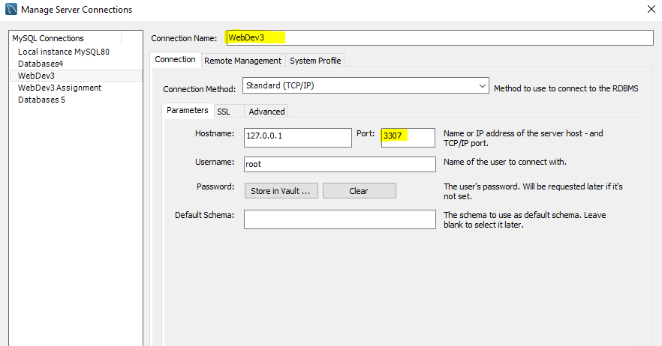
Creating Database Connection
Give your Connection a meaningful name
Check the Port setting … if 3306 in XAMPP worked, set this to 3306
If you had to update to 3307 … set 3307 here too
No need for username/password so leave as default

